Slide 1

Prediction of House Sale Price
Project 2
Suttinee Poolsup
June 18, 2025

Slide 2

Outline
Data Information
Data Cleaning
Exploratory Data Analysis
Data Visualization
Data Processing

Slide 3



Introduction
Dataset: Values of individual residential properties sold from 2006 - 2010
Regression Problem:
Which features of properties can have influential effects on the sale price?
Target: Sale price
How can we predict house prices using the previously collected dataset?

Slide 4
Data Information:
Dataset: Values of individual residential properties sold from 2006 - 2010
Rows: 2637 data entries
Columns: 81 variables excluding observation number
Nominal variable | 24
Ordinal variable | 23
Discrete variable | 14
Continuous variable | 20

Slide 5
Data Cleaning:
Rows: 2637 entries
Columns: 81 variables
Dataset
(1) Drop the identifier number (PID)
(2) Drop NaN
Non-null data
Entries | 2637
Variables | 54

Slide 6

Data Cleaning:
Non-null data
Rows: 2637 entries
Columns: 54 variables
Catagorical data (28)
Numerical data (26)
Data transformation
Boolean (bool) | 197
Numerical (int64) | 26
223 variables

Slide 7
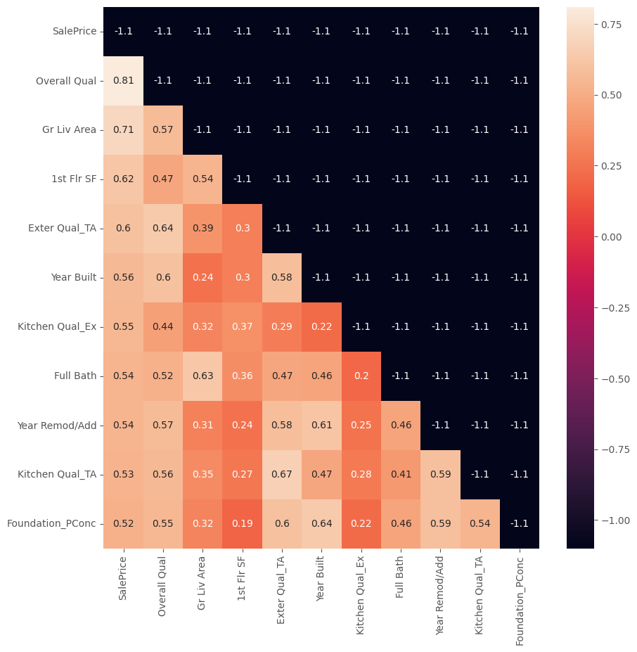
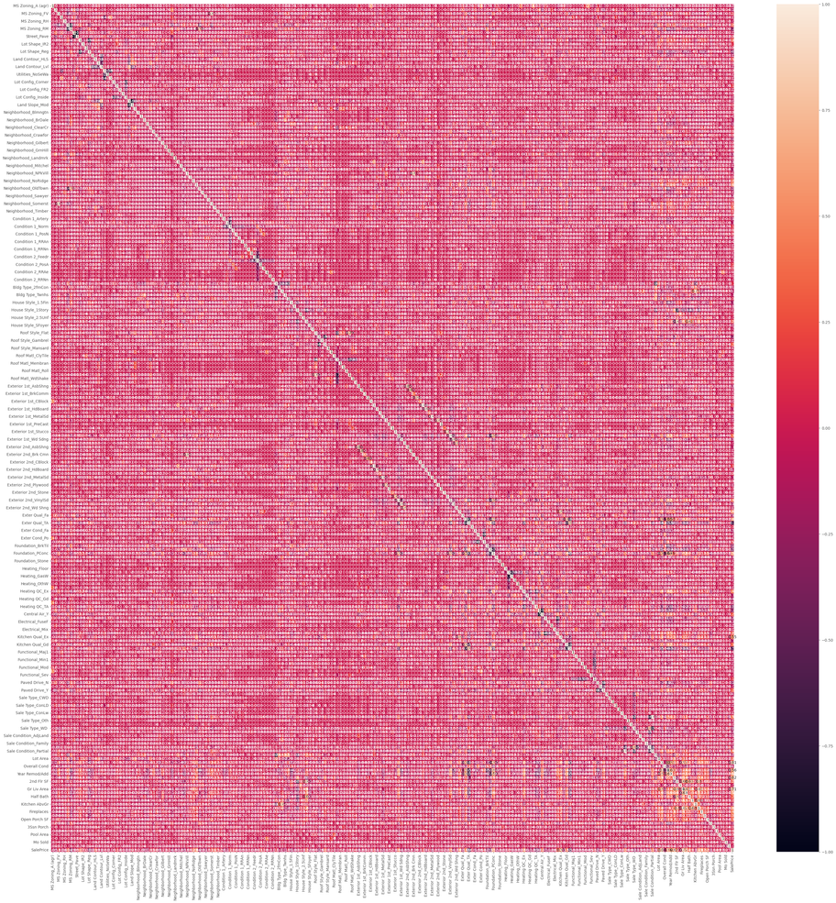
Exploratory Data Analysis:
Data correlation
0.5 < R2 < 1.0
222 variables
Due to their correlations with sale price, there are 10 variables selected as predictors of this model.

Slide 8
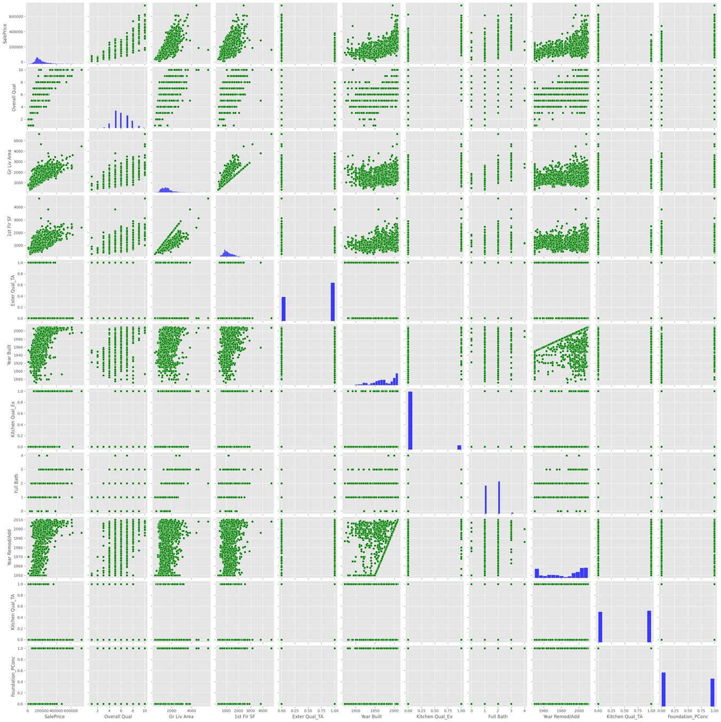
Exploratory Data Analysis:
Linear correlation ?
The pair plot shows the strong relationship of
Sale Price vs.
Gr Liv Area,
1st Flr SF,
Year Built
Year Remod/Add
Regression Models

Slide 9

Data Processing:
Regression Models
Linear regression
Lasso regression
Ridge regression

Slide 10
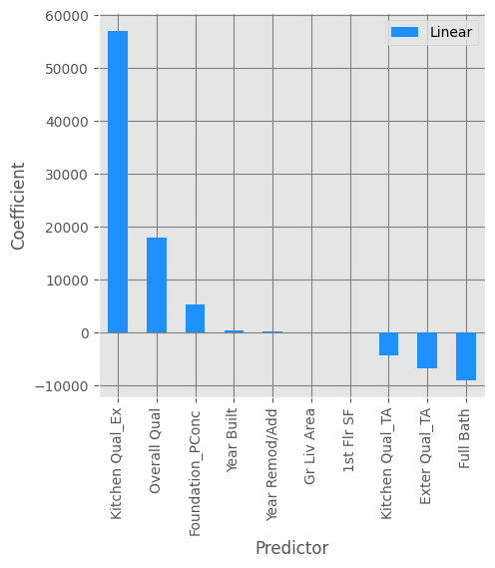
Data Processing:
Linear Regression Model
These four appear to be the positive direction of the relationship to the sale price.
Kitchen Qual,
Overall Qual,
Foundation_PConc,
Year Built,
Year Remod/Add coefficients
‘Kitchen Qual_Ex’ (Kitchen Quality - Excellent) shows the largest absolute value of the coefficient, indicating a stronger impact on the sale price.

Slide 11
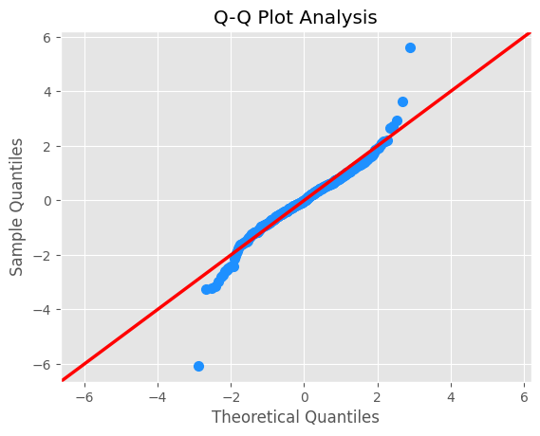
Data Processing:
Linear Regression Model
The Q-Q plot analysis indicates a distribution that is mostly normal in its central tendency but has fatter tails and likely some outliers compared to a true normal distribution.

Slide 12
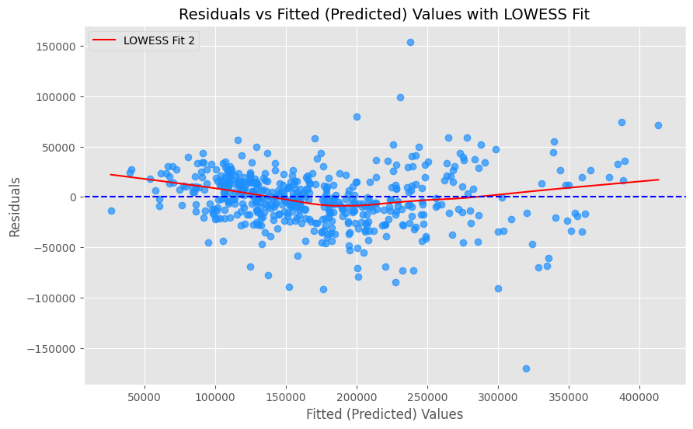
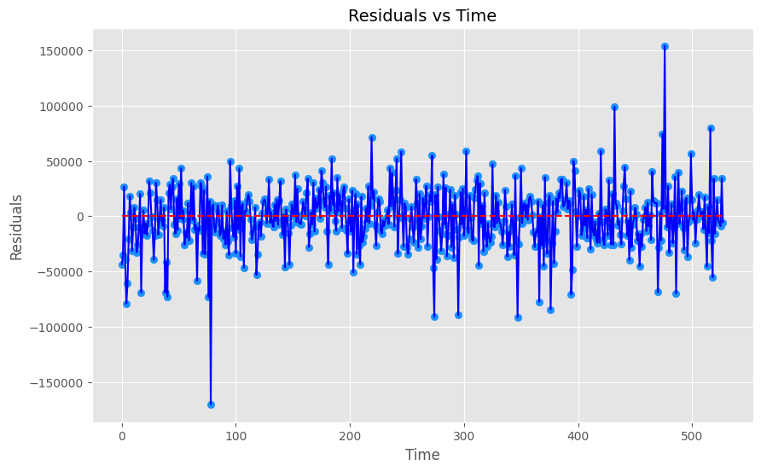
Data Processing:
Linear Regression Model
This residuals vs fitted plot shows a non-linear relationship meaning that this linear regression model is not a good fit for the data. The residual vs time suggests that the residuals are centered around zero with mostly constant variance.

Slide 13
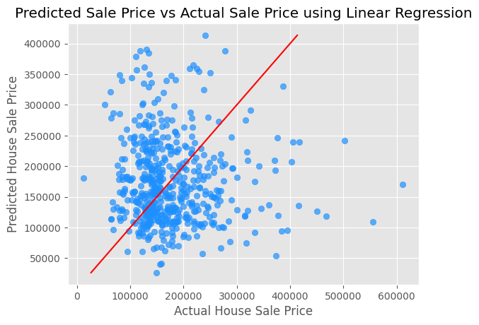
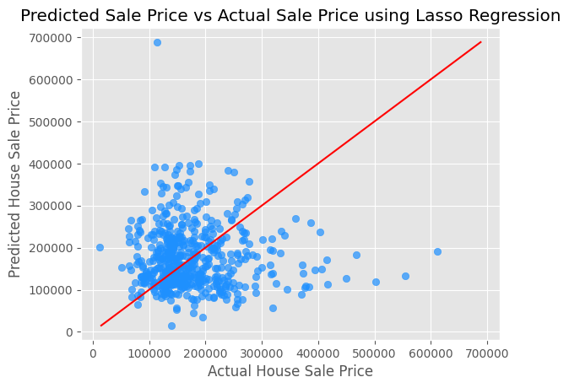
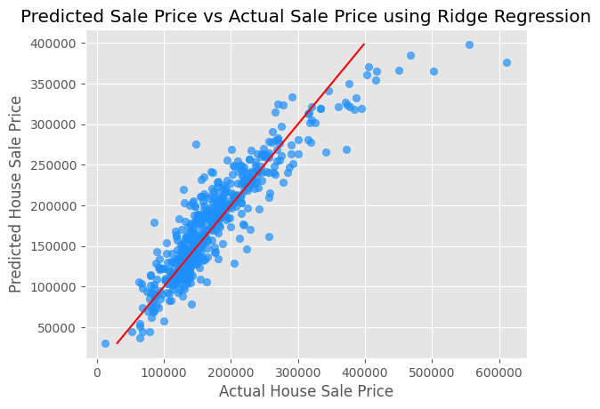
Data Processing:
Linear regression
Lasso regression
Ridge regression
These plots of all regression models show some positive correlation; however, there are also noticeable errors in the predictions.

Slide 14
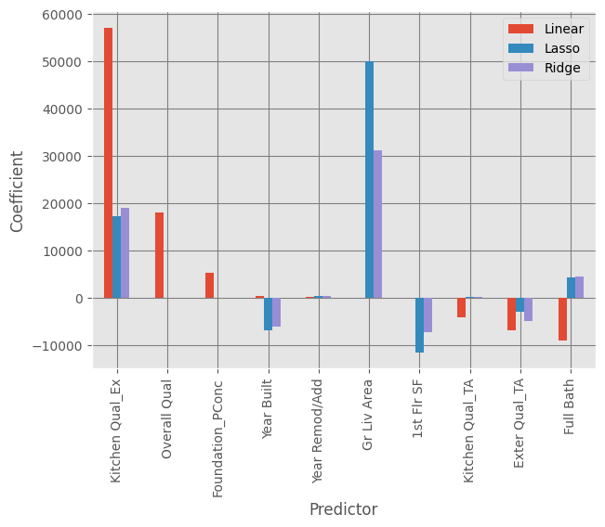
Data Visualization:
Regression Models
"Gr Liv Area" is the most important predictor.
"Kitchen Qual_Ex" is also a very important positive predictor.
"Full Bath" is a moderately important positive predictor.
Regression | % RMSPE
Linear | 20.87
Lasso | 20.77
Ridge | 20.87

Slide 15
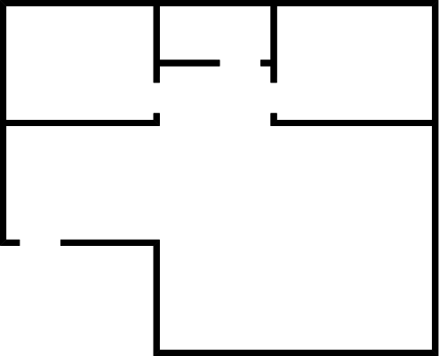
Conclusion
RMSPE provides the average percentage by which regression model's predictions deviate from the actual values. Comparing the RMSPE across Linear, Lasso, and Ridge models helps to understand which regularization technique (or none at all) provides the best relative predictive accuracy for this specific problem, taking into account the scale of the target variable.
On average, the predictions using these three models are off by about 21% of the actual house sale price in the data set of the selected 10 features.
Lasso regression performed automatic feature selection by setting the coefficients of less important variables to exactly zero. This helps to create a sparser and potentially more interpretable model by identifying and discarding irrelevant features.
For all models, "Kitchen Qual_EX" and "Gr Liv Area" features are likely the most important predictors of house sale price of this dataset.
"Gr Liv Area"
"Kitchen Qual_EX"

Slide 16


Future Exploration
To increase the accuracy of the model prediction, the addition of data operations ( such as transformation of the data types and data imputation) is needed to improve the list of predictors
Different types of regression models should be explored to create a better-fitting model with the data.

Slide 17

Takeaways
Feature selection in data cleaning and choosing a model type can be key elements to create a robust model with better accuracy for data prediction.
The shifts in coefficients from the linear model to Lasso and Ridge models highlight the benefits of regularization in identifying true feature importance and handling potential issues such as multicollinearity.
Lasso, in particular, performs aggressive features that are truly essential for the prediction. However, the choice between Lasso and Ridge often depends on whether the preference to focus on either the feature selection (Lasso) or just coefficient shrinking (Ridge) is more appropriate for the data and problem.

Slide 18
Reference:
The original data is available on AWS S3 at https://ddc-datascience.s3.amazonaws.com/Projects/Project.2-Housing/Data/Housing.Data.csv .
Data science lecture materials
Explanation of lasso and ridge regressions: https://www.geeksforgeeks.org/ridge-regression-vs-lasso-regression/

Slide 19



Thank
You

